Slide 1
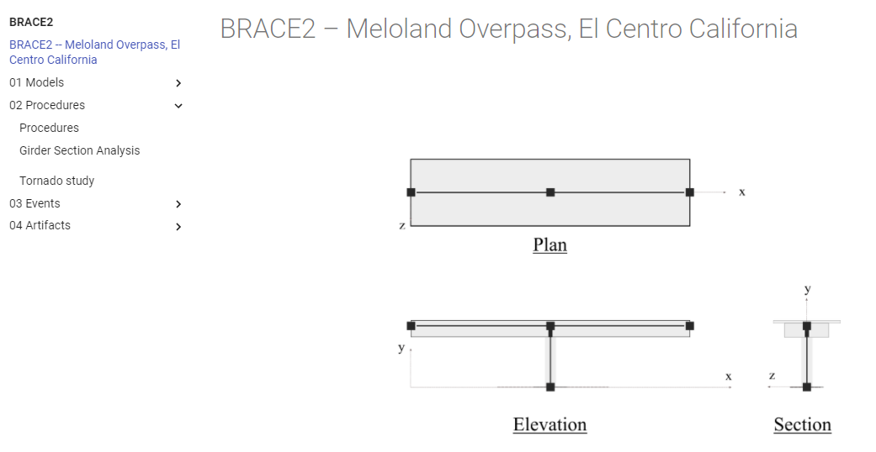
Decision Making Platform: Meloland

Slide 2
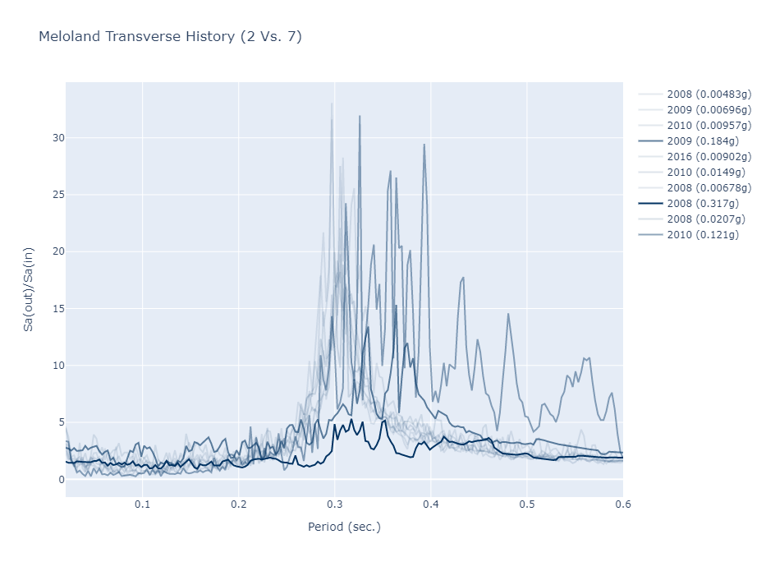

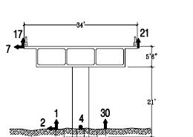
System Identification Over Time: Meloland
T=0.29 sec
First mode period in transverse direction
ζ=12%
T=0.2~0.3 sec → Stiff bridge, large damping ratio due to SSI
Explored with other data & SI methods

Slide 3
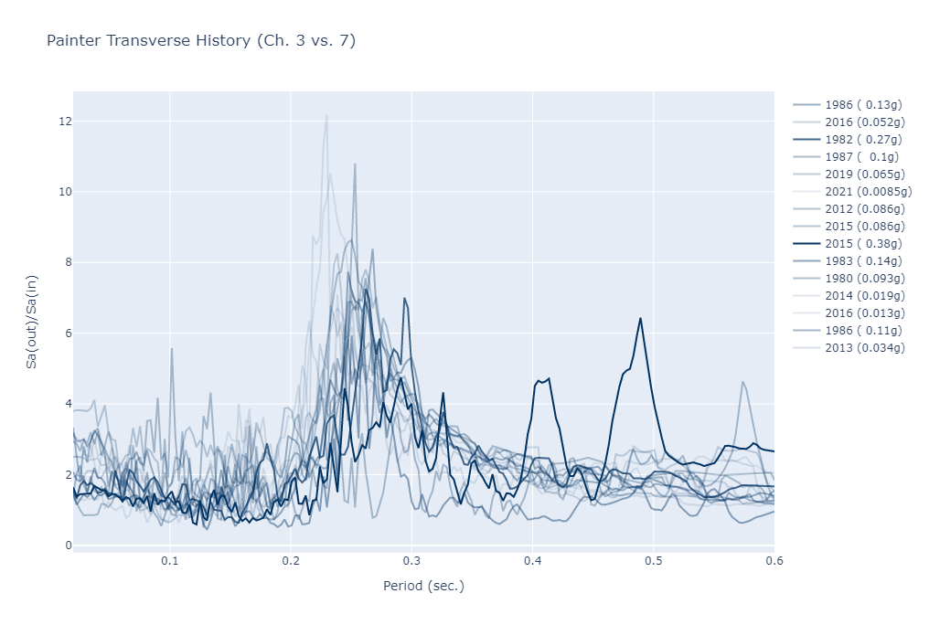

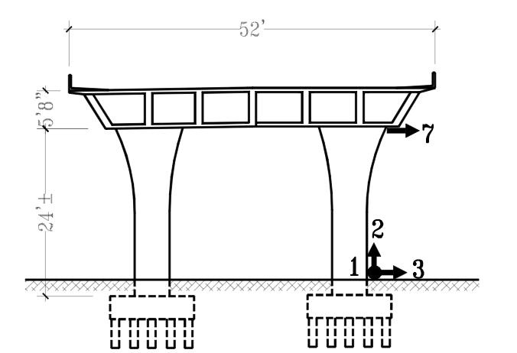
System Identification Over Time: Painter Street

Slide 4
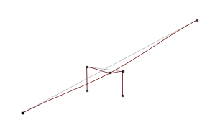

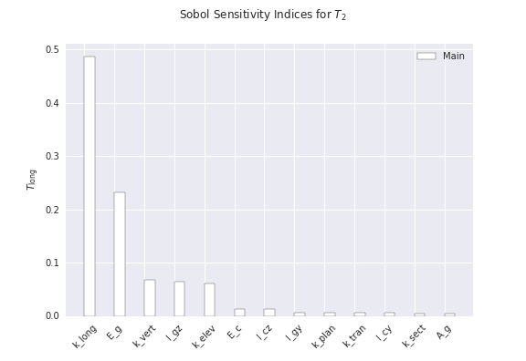
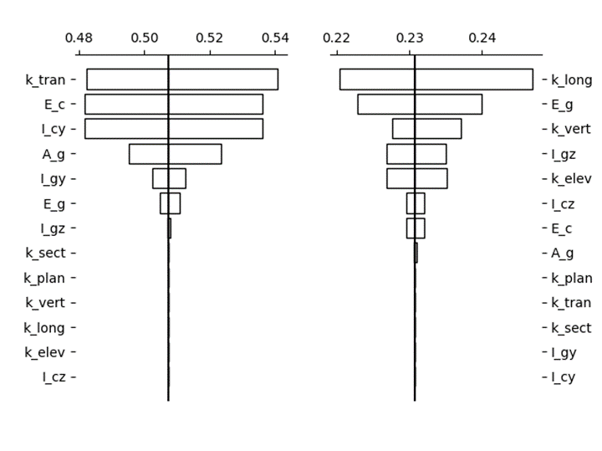
Sensitivity Methods

